Slide 1
Horizon Results Booster
Info Session | 17th of November 2022
Portfolio Dissemination & Exploitation Strategy Module C
Business Plan Development
Prepared by Antonello Fiorucci

Slide 2
The Key Exploitable Result (KER) is the hero!
Responding to specific needs, to the demand of a well-defined group of “customers”
Selected by the partners for use and/or market introduction
A product or process
A new service
A new policy
New standard
New training courses
Input for a new project
I am not just a patent!

Slide 3
Service 1: Portfolio Dissemination & Exploitation Strategy
Module C

Slide 4
The Exploitation Strategy Seminar (ESS) is the core of the PDES-C
The seminar lasts for one day/two half days
For the KER owners, the Coordinator and the Exploitation Team, but all Partners are suggested to participate and contribute
Best if organized before the midterm of a project life
A unique opportunity to discuss Exploitation Plan next steps and have an insight on KERs
Focus on a maximum 3 KERs
The Final Report provides inputs for making the most out of the exploitation activities in the project’s work plan:
Characterisation table, Priority map, Exploitation Roadmap, Recommendations

Slide 5
PDES-C Approach
Focus not on the scientific dimension but on the KER’s key features related to its use with a problem oriented (demand driven) approach
Concentrate on how to increase the TRL after the project is ended having in mind possible lack of resources
Key ingredients: Unique Value proposition - UVP, Use model, Early adopters (target audiences for dissemination)

Slide 6
Seminar Objectives
Introduce: impact, KERs, use and their relationship
Focus on KERs and discuss:
Problems addressed - alternative solutions - unique value proposition - novel solution and use model
Risks related to the use of results (possibly) and
First actions after the project’s end

Slide 7
ESS Agenda
Day 1
Introducing Exploitation
Definitions of Exploitation
Key Exploitable Results
Exploitation vs Dissemination
Exploitation Plan
Q&A
Day 2
Working session for KER1
Characterisation Table
Risk Map
Exploitation Roadmap
Working session for KER2
Characterisation Table
Risk Map
Exploitation Roadmap
Working session for KER3
Discuss for KER3 the Characterisation Table
Risk Map
Exploitation Roadmap
Notes:
09.00 : 10.30 - Working session for KER1
Discuss for KER1 the Characterisation Table, the Risk Map and the Exploitation Roadmap.
10.30 : 11-00 - Break
11.00 : 12:30 - Working session for KER2
Discuss for KER2 the Characterisation Table, the Risk Map and the Exploitation Roadmap.
12.30 : 13-30 - Lunch break
13.30 : 15:00 - Working session for KER3
Discuss for KER3 the Characterisation Table, the Risk Map and the Exploitation Roadmap.
15.00 : 15:30 – Closing

Slide 8
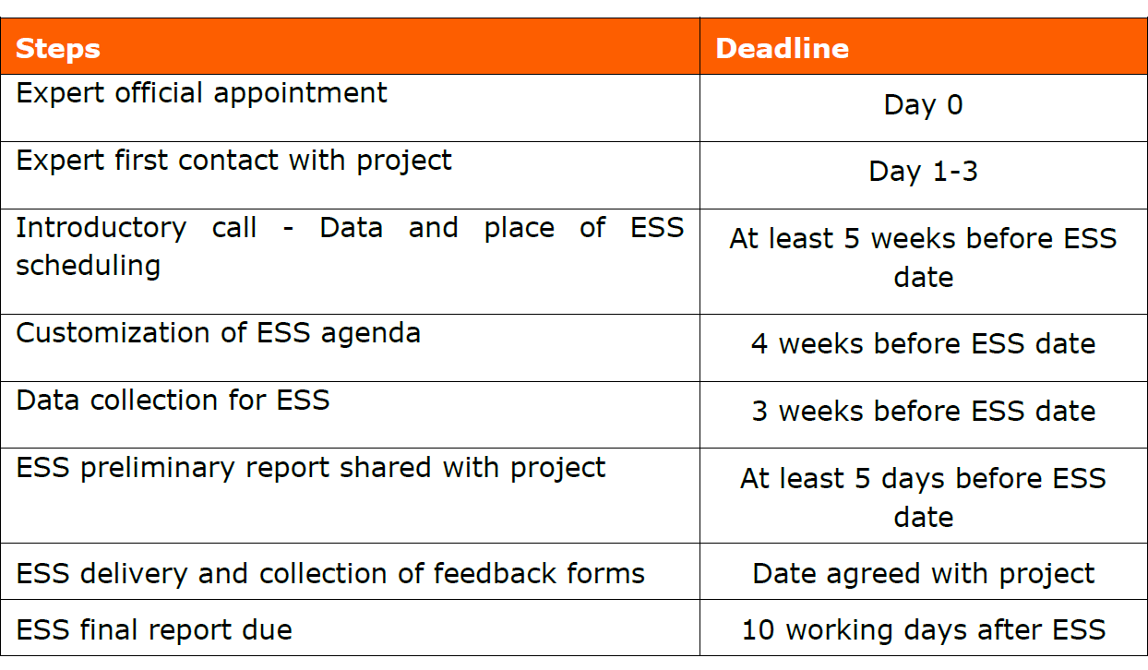
Delivery Steps

Slide 9
Service 2: Business Plan Development (BPD)

Slide 10
BPD Overview
Support to partners for having a structured business/exploitation plan (in the case the result will not be commercialized) for 1 (one) KER
Support is customised according to the maturity of the KER selected
If a draft business/exploitation plan is available, the Experts will help you review it, prepare an implementation roadmap and provide recommendations for its finalisation
If the KER is just characterised (no draft available), the Experts will support you in identifying the information to be collected and validated for drafting the plan, discussing use/business model and provide recommendations on how to prepare it

Slide 11
Main Elements
Focus on 1 KER
Best if organized after the midterm of a project life – after a PDES C
The service delivery lasts for 2 months
For the KER owner/s, the Coordinator and the Exploitation Team, but all Partners are suggested to participate and contribute
The Final Report provides inputs for planning future use:
Characterisation table, Lean/Value Proposition Canvas, Exploitation Roadmap, Recommendations

Slide 12
Activities (1/3)
1
Introducing service delivery
Task 1 – Contacting the beneficiary
Contacting the beneficiary, sending and collecting the Pre-assessment template and BOSAT form
Task 2 – Agreeing on activities (Service Delivery Plan - SDP)
Within 7 working days, organise a call with the Coordinator to discuss the content of the service, collect feedbacks and agree on the next steps and their timing
Task 3 – Prioritizing support
The Expert asks the Coordinator to run the BOSAT

Slide 13
Activities (2/3)
2
Preparation of the workshop
Task 1 – On-line capacity building
Webinar on Lean Canvas
Attendees will receive tools and templates to be used in the next steps (Business Plan structure template, Lean Canvas roadmap)
Task 2 – BPD workshop
Beneficiaries provide the first version of the Lean Canvas and Business Plan
Expert sends the First Set of Guidelines
Workshop covering:
An introduction to business planning
Review of the Lean Canvas
Focus on revenue streams and costs structure
Drafting the implementation roadmap
Notes:
Task 1 – On-line capacity building
Webinar on Lean Canvas
After webinar sending tools and templates to be used in the next steps (The Business plan structure template, Lean canvas e roadmap).
Task 2 – BPD- workshop
Ten days before the delivery of the workshop, the Expert will ask beneficiaries to provide the first version of the Lean Canvas and the Business Plan Structure they produced.
Five days before the workshop the Expert sends the First Set of Guidelines.
Workshop covering (to be finetuned according to the specific needs):
An introduction to business planning.
Review of the Lean Canvas.
Focus on revenue streams and costs structure.
Drafting the implementation roadmap.

Slide 14
Activities (3/3)
3
Finalising the service
Task 1 – Follow-on coaching to further discuss aspects such as:
How to reach out early adopters
Business model with revenues and costs
Financial needs
Next steps after the end of the project - Implementation roadmap
Task 2 – Implementation plan and final report
Reviewing all materials produced and adding recommendations for the future implementation of the business plan
The Expert prepares a BPD Final Report summarising recommendations and information on next steps
Fill in the feedback form
Notes:
Task 1 – Follow-on coaching
Follow-on session to further discuss less developed aspects such as:
How to reach out early adopters (not the consortium partners or your “family and friends”).
Business model with revenues and costs.
Financial needs.
Next steps after the end of the project - Implementation roadmap.
Task 2 – Implementation plan and final report
Reviewing all materials produced (characterisation table, lean canvas and implementation roadmap) and adding recommendations for the future implementation of the business plan.
The Expert prepares a BPD Final Report summarising recommendations and information on next steps.
The Coordinator/Applicant will be asked to fill “Leave your feedback” questionnaire.

Slide 15
BPD Workshop Agenda
Ice breaking
Pre-meeting with the Coordinator, Welcome, Presenting the day
Towards an effective Exploitation Strategy: The business planning process
Introducing Business planning “Business plan is a journey”, Q&A session
Towards an effective exploitation plan
Working on the Lean Canvas and on the first draft of the Business Plan structure template
The Exploitation Roadmap
Discussing the key actions to be performed after the project’s end
Sharing results open discussion

Slide 16
Delivery Steps
Steps | Deadline
Expert official appointment | Day 0
Expert first contact with project | Day 1-3
Introductory Call | Within one week form first contact
Lean Canvas Webinar | 3 weeks before BPD
Collection of draft Business Plan Structure, Roadmap and Lean Canvas | 10 working days before BPD
First set of guidelines submitted | 5 working days before BPD
BPD workshop and collection of feedback forms | Data agreed with project
BPD final report due | 2 weeks after BPD seminar

Slide 17
To keep in mind, before you start…
The «Booster» is a learning experience
Allignement of the expectations
Focus on the deadlines
Focus on the key concepts
Clarity of purposes of the tools

Slide 18
“You do not really understand something unless you can explain it to your grandmother.” - Albert Einstein

Slide 19
Antonello Fiorucci
a.fiorucci@meta-group.com
www.horizonresultsbooster.eu

Slide 20
AT A GLANCE
Whole study of corrosion and its consequences in the different parts of a WT structure.
O&M tools integrating accurate structural health in offshore energy
Design and validation in field of smart corrosion monitoring solution based on a network of ultrasound sensor nodes.
Corrosion testing in lab and in field (atmospheric and splash zones).
SOCIETAL CHALLENGES - Secure, clean and efficient energy
Robust wireless communications network to operate inside metallic structures.
PDESC, BPD
Design and validation in field of a drone based monitoring solution.
2019 - 2022
Design and validation of corrosion and coating degradation models and corrosion prognosis methodology incorporating those models.
Ceit (ES), COBRA (ES), Semantic Web Company (AT), Delft Dynamics (NL), Flanders Make (BE), PLOCAN (ES), SINTEF Industry (NO), SINTEF Energy Research (NO), TU Delft (NL)
Weather and Operation Forecast Tool for short term and long term.
Design of load reduction control for offshore turbine tower. Multi-mode vibration model to reduce the loads on critical locations.
Ainhoa Cortés, Associate Director of Electronic Systems and Communications Group CEIT
Tool for probabilistic analysis of turbine dynamics in the frequency domain. A module of farm-scale turbulence that supports computationally efficient multiscale stochastic simulations in the time domain.
www. watereye-project.eu

Slide 21
AT A GLANCE
5 products
Replication, Market Uptake and Deployment Handbook
Mobility Environmentally-friendly, Integrated and economically Sustainable Through innovative Electromobility Recharging infrastructure and new business models
Roaming and Accounting Platform
Integrated Real-Time Information & Booking Services
SOCIETAL CHALLENGES - Smart, Green And Integrated Transport
European eMobility Expertise Centre (EeMEC) and eSUMPS knowledge base
Smart Charging and Storage Platform
PDESA, PDESC, BPD, GTM
2018 - 2022
6 business models
ETRA I+D (ES), Malaga City Council (ES), Novadays (ES), VMZ (DE), IKEM (DE), GEWOBAG (DE), CERTH (GR), RISE (SE), E.ON (DE), SenUMVK (SE), Stockholms Stad (SE)
Smart Park & Charge
E-carsharing in the municipal fleet
E-carsharing as a housing service
Ángel Moya, Project Manager ETRA
Delivery of Home Care Services with EV’s
www.meisterproject.eu
Smart Charging
City e-logistics in ultra low emission hubs

